Slide 1
Quantum Image Classification on Amazon Braket
A K M Muhitul Islam

Slide 2
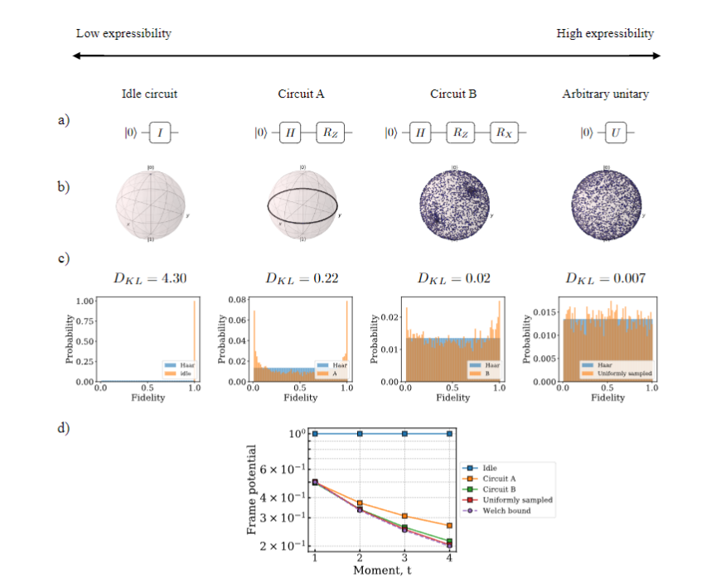
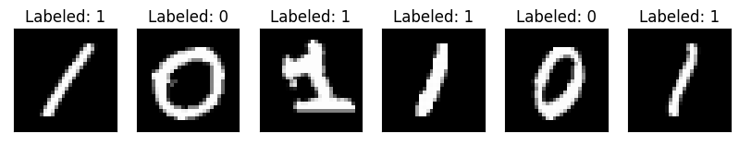
Background and Objectives
The project explores the substantial potential of quantum computing in revolutionizing data processing and analysis, focusing on quantum image classification.
Comprehending quantum machine learning and its application in image classification.
The project focuses on leveraging Amazon Braket for quantum image processing.
Implementing a quantum circuit for binary classification of MNIST dataset images.
[1]

Slide 3
Significance
Quantum image processing (QIP) addresses the limitations of classical computing in handling large datasets and high-dimensional data, especially in real-time processing.
QIP utilizes quantum mechanics principles like superposition and entanglement, offering more efficient computation than classical methods.
The project demonstrates the use of quantum circuits for image classification on Amazon Braket, highlighting a practical application of quantum advantage.
The research has potential implications across various sectors like healthcare, security, and autonomous vehicles, where efficient image classification is crucial.

Slide 4
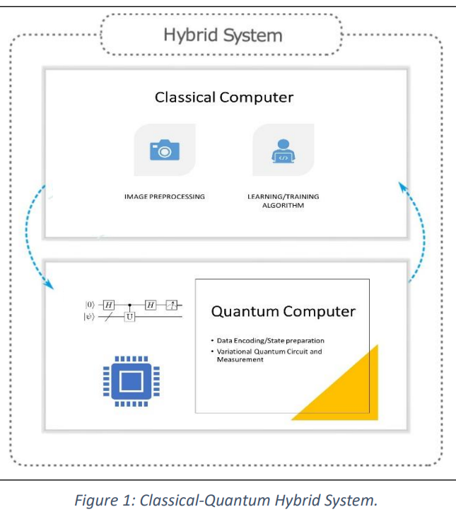
Methodology
Quantum Machine Learning (QML) is an emerging field at the intersection of quantum computing and machine learning. It leverages the principles of quantum mechanics to enhance machine learning algorithms.

Slide 5
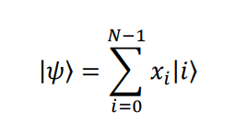
Image Preprocessing
Edge Detection: Initial step to enhance image features, crucial for accurate classification.
Dimensionality Reduction: Using Principal Component Analysis (PCA) to simplify the image data, making it more manageable for quantum processing.
Amplitude Encoding: Transforming the processed image data into a format suitable for quantum circuits.

Slide 6


Methodology
Variational Quantum Circuits: Utilized for binary image classification.
Parametric Nature: VQCs have adjustable parameters, similar to weights in neural networks.
Integration of Rotation Gates: Enhances the circuit's capability to process complex data.
Qubit Entanglement: Emphasized for capturing correlations between data points.
Sigmoid Function Application: Used for deriving the final prediction from quantum measurements.
Quantum Measurement Divergence: Highlights differences in quantum machine learning compared to traditional quantum computing.
Potential in Image Classification: Demonstrates VQC's ability to handle complex classification tasks.

Slide 7
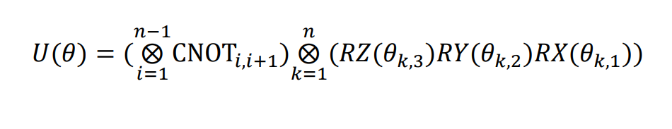
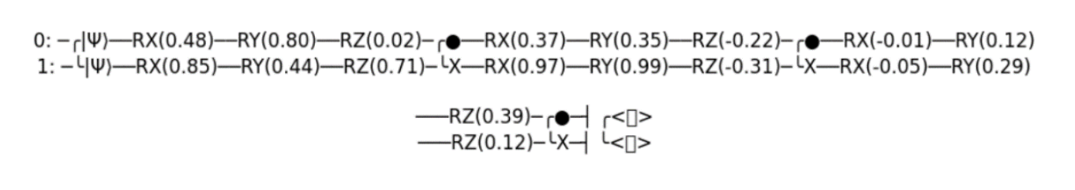
QML

Slide 8
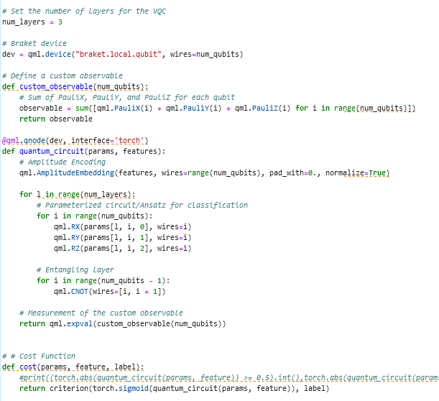
QML

Slide 9
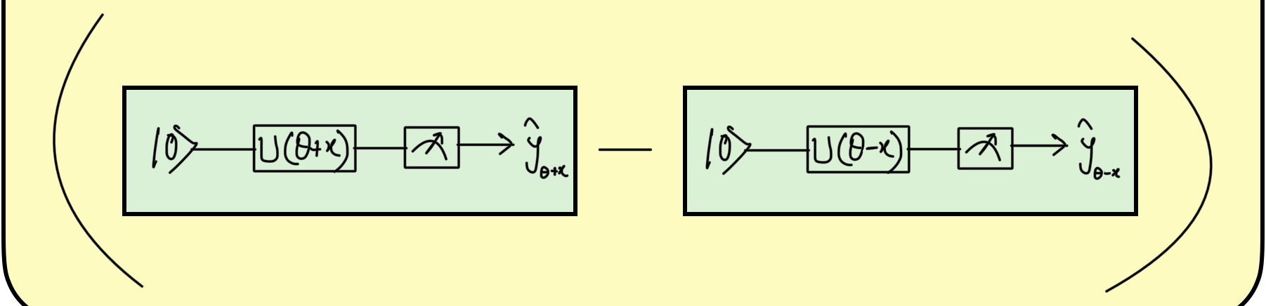
Methodology
Optimizing Parameters: The training involves minimizing a cost function to enhance classification accuracy.
Binary Cross-Entropy Loss: This function is used for its suitability in scenarios where model predictions are probabilities.
Gradient-Based Learning: The process involves computing gradients of the cost function and iteratively updating parameters in the opposite direction of these gradients.
Parameter Shift Rule: This method is employed for efficient gradient computation in the quantum setting.
Training Efficacy: The combination of BCE Loss and parameter shift rule provides a robust framework for training variational quantum circuits.

Slide 10
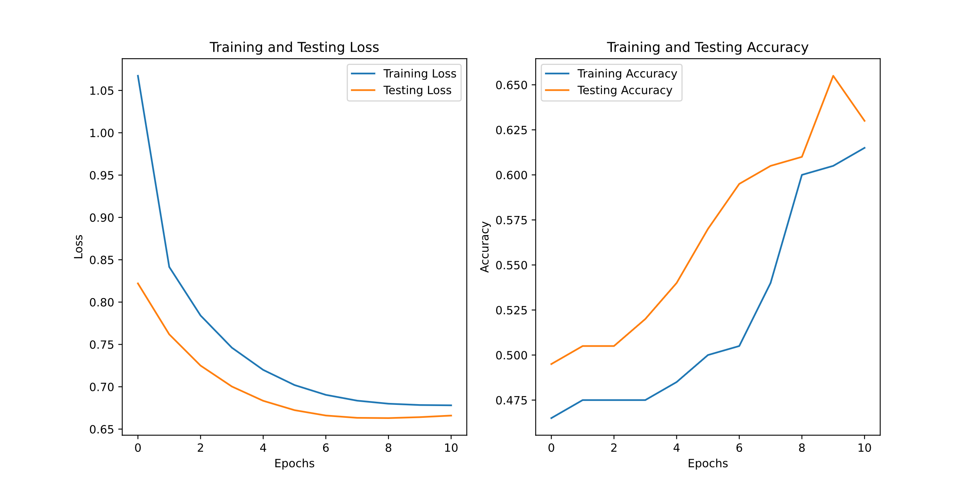
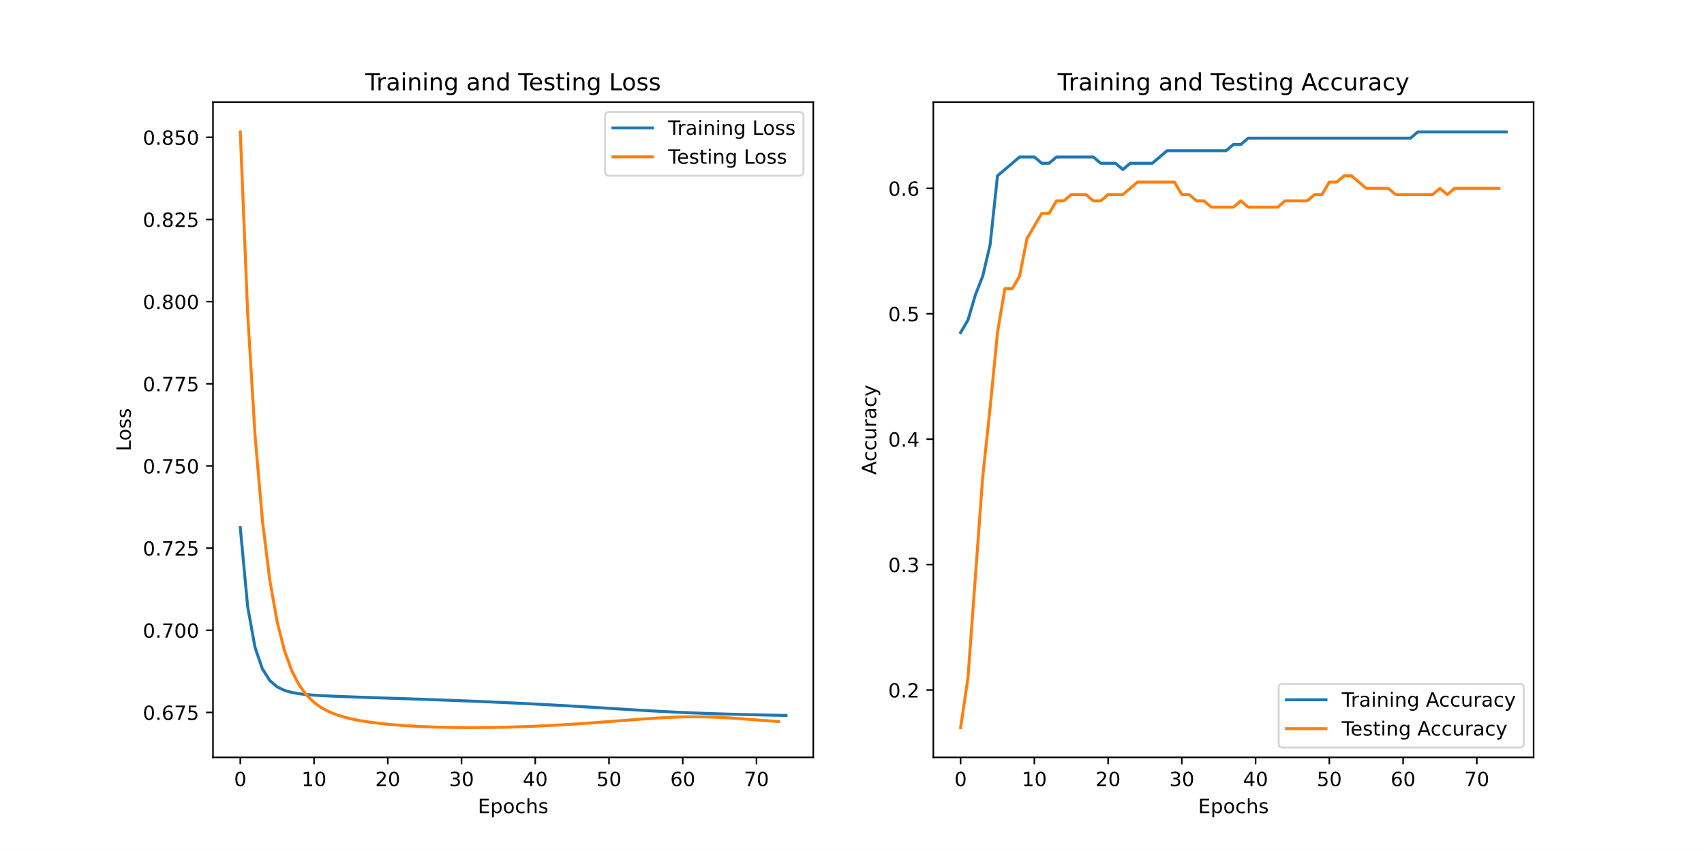
Evaluation

Slide 11
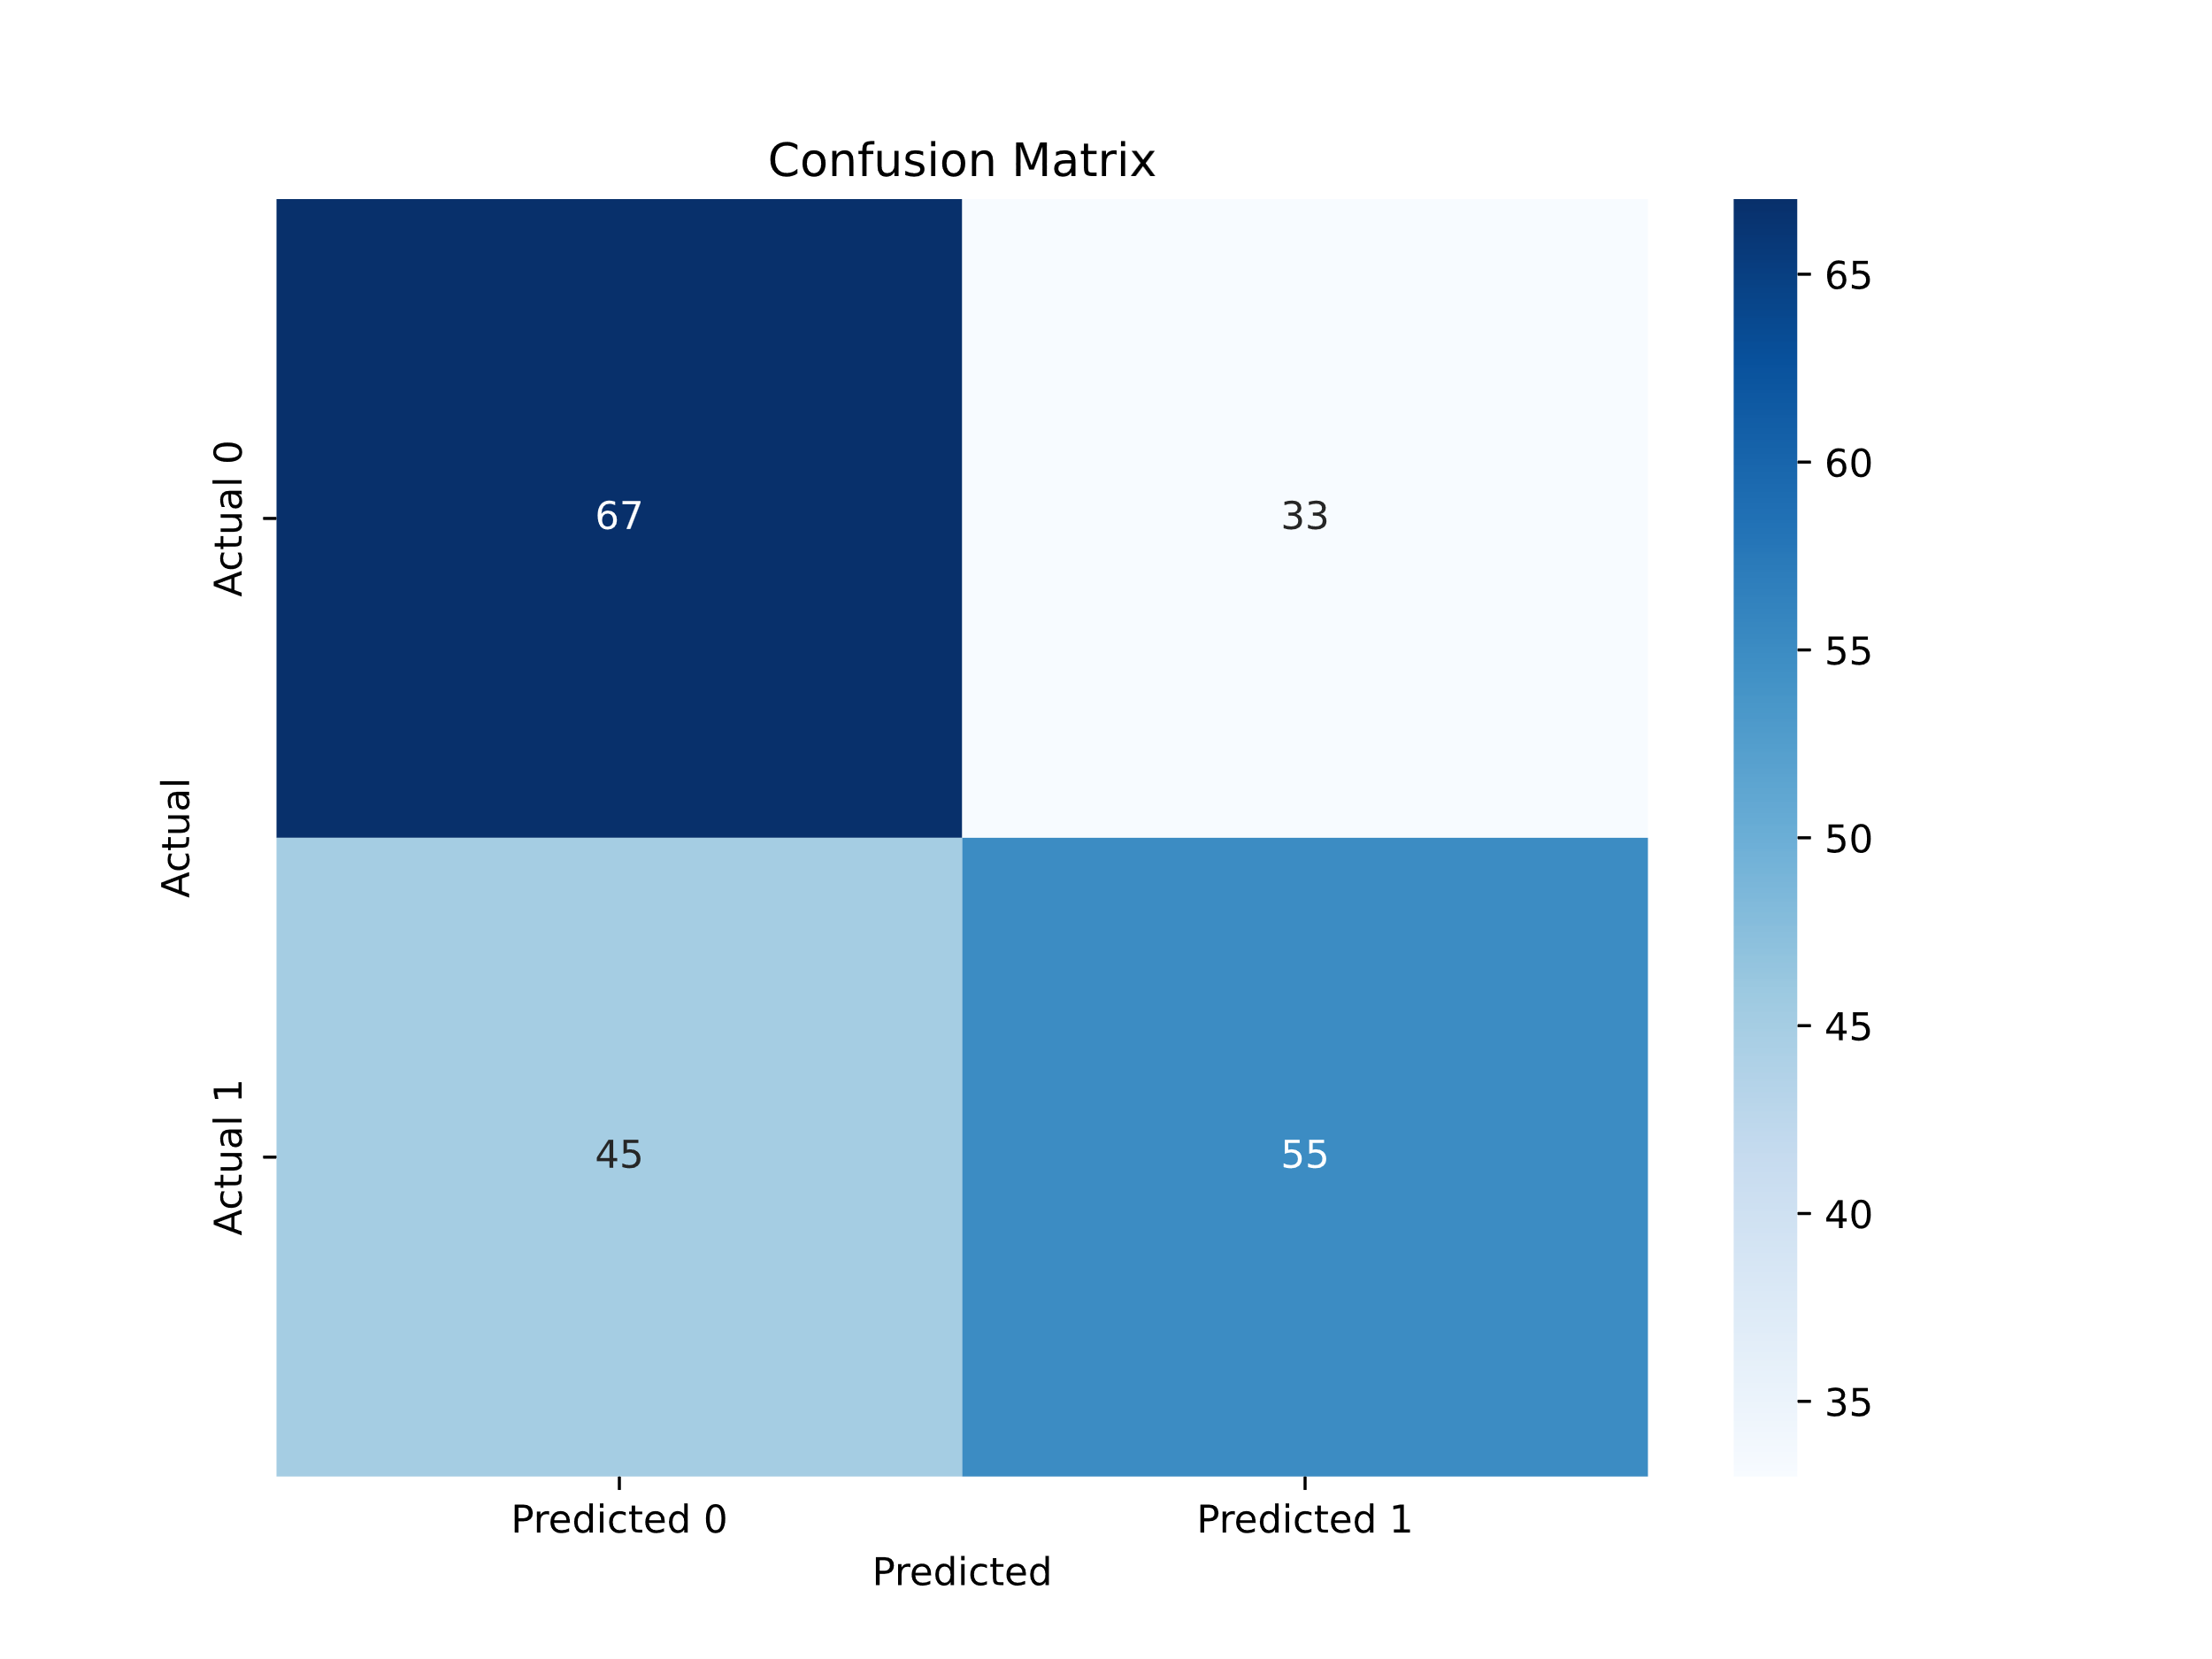
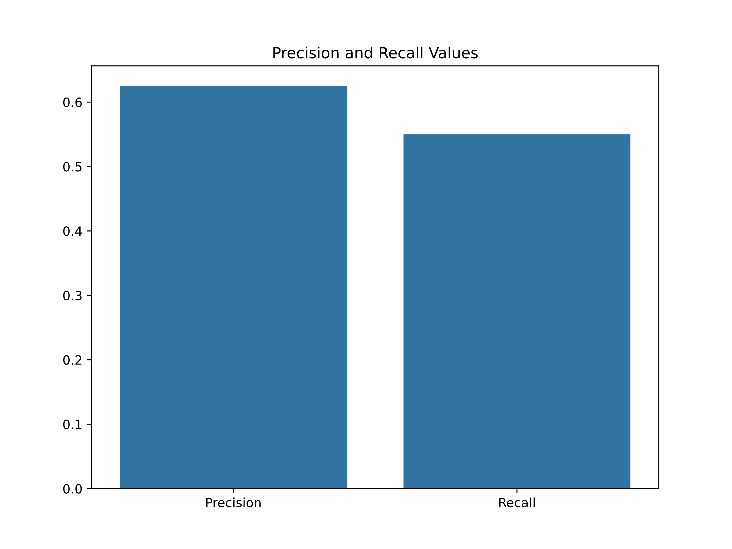
Evalutions

Slide 12
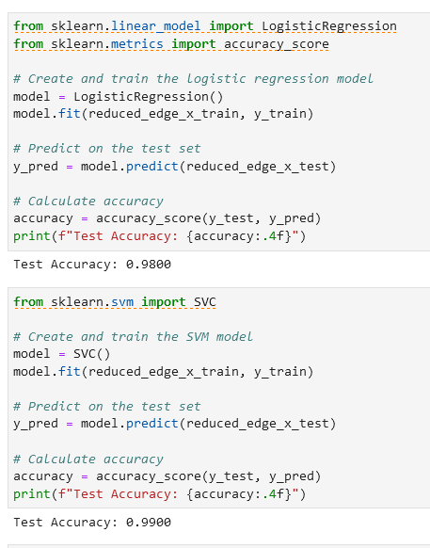

Slide 13
References
Sim, Sukin, et al. “Expressibility and Entangling Capability of Parameterized Quantum Circuits for Hybrid Quantum‐Classical Algorithms.” Advanced Quantum Technologies, vol. 2, no. 12, Oct. 2019. https://doi.org/10.1002/qute.201900070.
All Code QCproject.ipynb
https://github.com/akmmuhitulislam/quantum-computing-courseproject

Slide 14

Thank You

